Slide 1
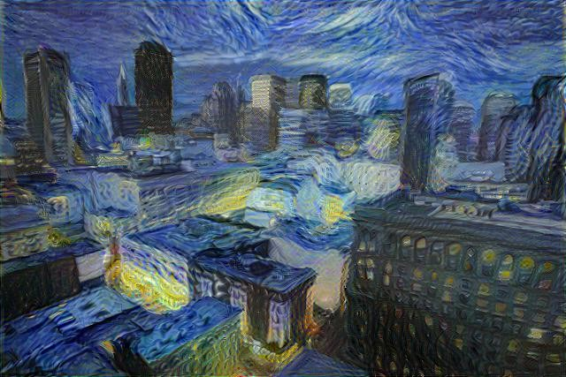
NEURAL STYLE TRANSFER USING CONVOLUTIONAL NEURAL NETWORKS
A.V.R.JATIN

Slide 2
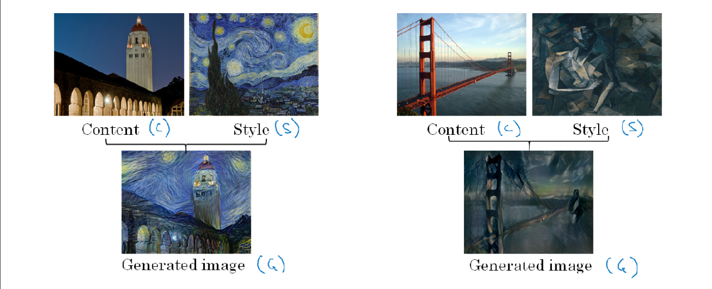
NEURAL STYLE TRANSFER
Neural style transfer is an optimisation technique used to transform two images, a content image, a style reference
image (such as an artwork by a famous painter), and blend them together such that the content image is
transformed to to be “painted” in the style of the style image.

Slide 3
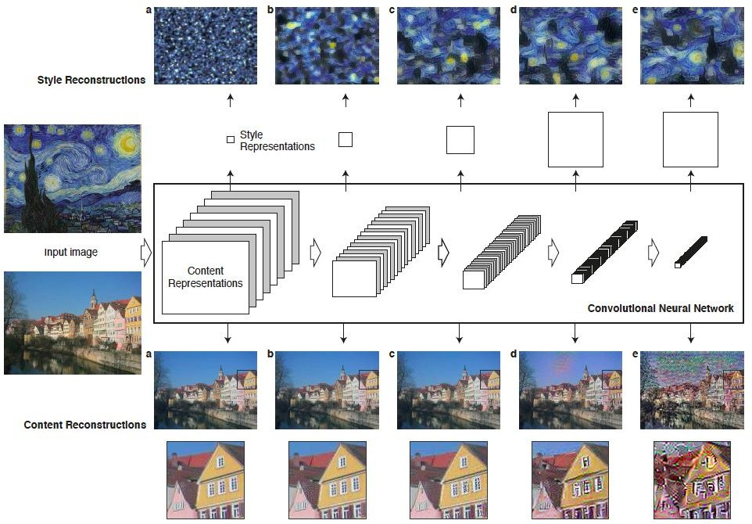

OVERVIEW OF METHOD
CONTENT: Global structure.
STYLE: Colours; local structures.
Use CNNs to capture style from one image and content from another image.
Feature representations Filter correlations
Content Style

Slide 4
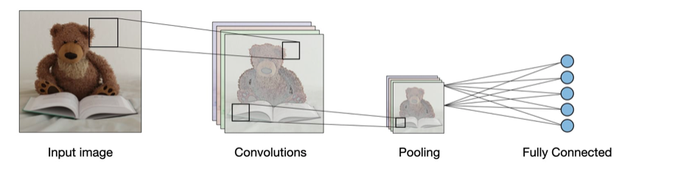
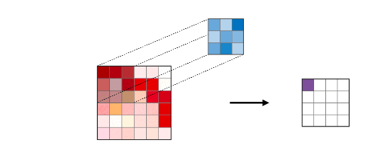
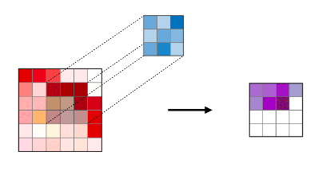
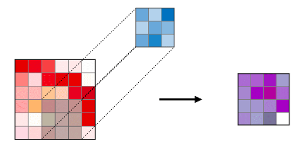
ARCHITECTURE OF a traditional CNN
Convolutional neural networks, also known as CNNs, are a specific type of neural networks that are generally composed of the following layers:
CONVOLUTION LAYER (CONV) - The convolution layer (CONV) uses filters that perform Convolution operations as it is scanning the input I with respect to its dimensions. Its Hyperparameters include the filter size F and stride S. The resulting output O is called Feature map or activation map.

Slide 5
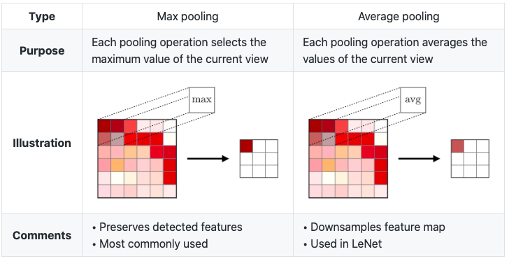
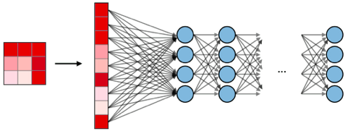
POOLING (POOL) - The pooling layer(POOL) is a downsampling operation, typically applied after a convolution layer,
Which does some spatial invariance. In particular, max and average pooling are special kinds of pooling where the
Maximum and average value is taken, respectively.
FULLY CONNECTED (FC) - The fully connected layer (FC) operates on a flattened input where each input is connected
to All neurons. If present, FC layers are usually found towards the end of CNN architectures and can be used to
optimise Objectives such as class scores.

Slide 6
VISUALISING WHAT A DEEP NETWORK IS LEARNING
Pick a unit in layer 1. Find the nine image patches that maximise the unit’s activation.
Repeat for other units.

Slide 7
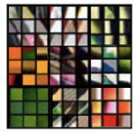
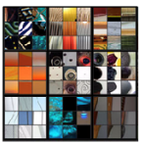
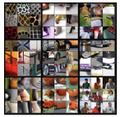
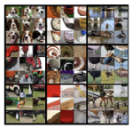
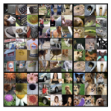
VISUALISING DEEP LAYERS
LAYER 1
LAYER 2
LAYER 3
Detects relatively simple features
such as edge or a particular shade of color.
Detects vertical lines and round shapes.
Detects honeycomb shapes and square shapes.
LAYER 4
LAYER 5
Detects water, legs of a bird.
Detects humans, animals and text.

Slide 8
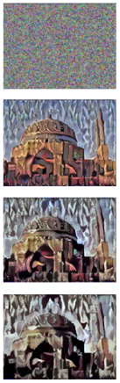
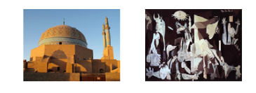
FIND THE GENERATED IMAGE G
Initiate ‘G’ randomly:
G : 100 x 100 x 3
2. Use Gradient descent to minimise J(G):
G = G - α/2(J(G))

Slide 9
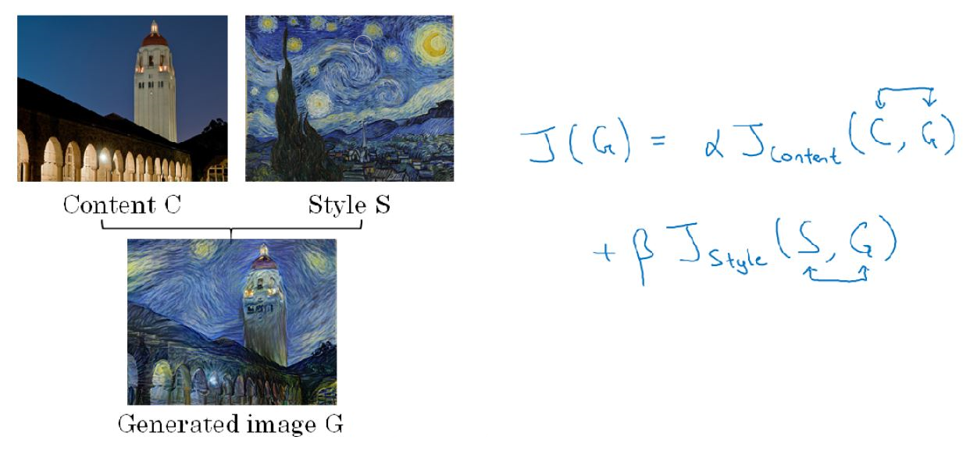
NEURAL STYLE TRANSFER COST FUNCTION

Slide 10
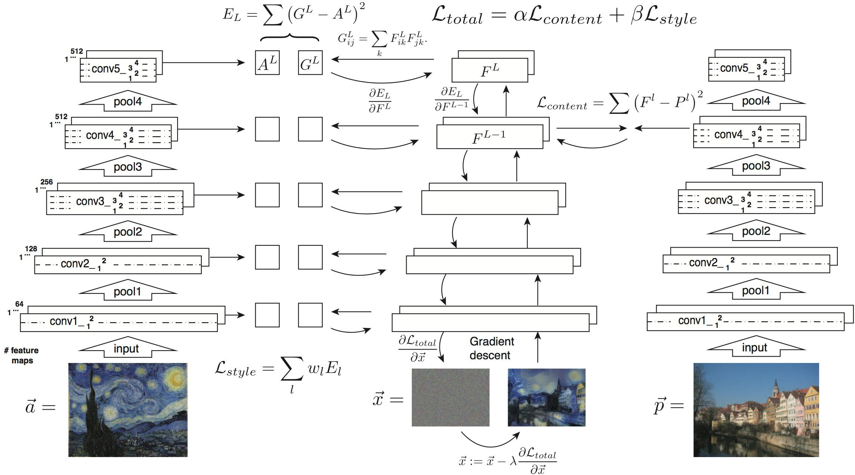
The Total COST Function

Slide 11
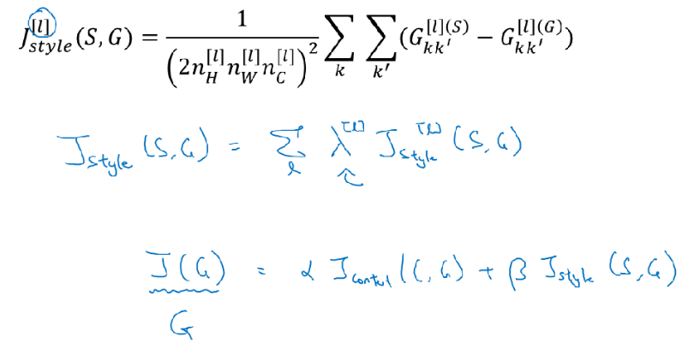
STYLE COST FUNCTION
CONTENT COST FUNCTION
So, the overall style cost function, you can define as sum over all the different layers of the style cost function
for that layer. So what it does is allows you to use different layers in a neural network. Well of the early ones,
which measure relatively simpler low level features like edges as well as some later layers, which measure high
level features and cause a neural network to take both low level and high level correlations into account when
computing style.

Slide 12
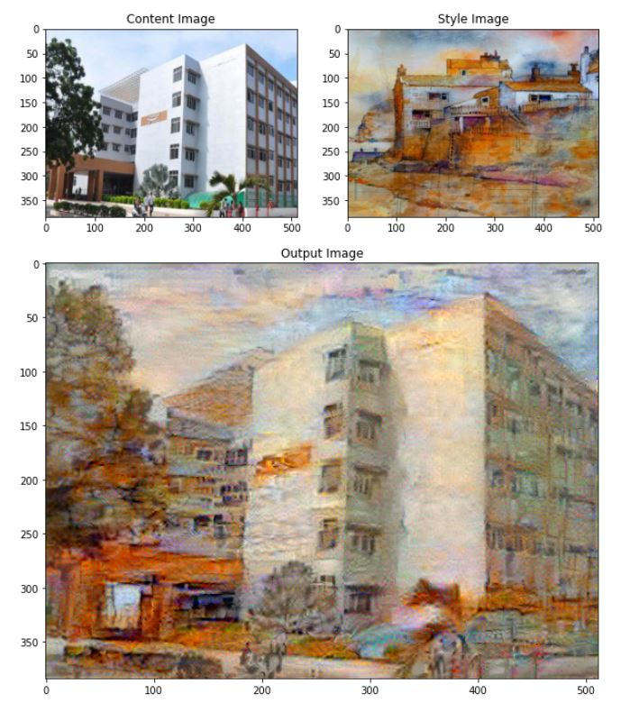

Slide 13
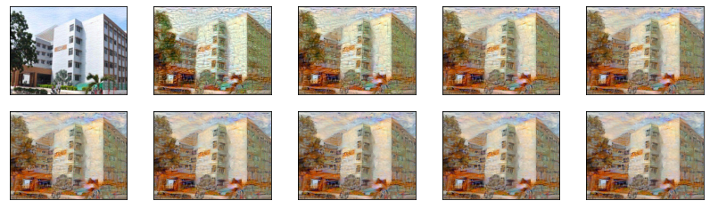
0th iteration
Generated image at various iterations
100th iteration
200th iteration
300th iteration
400th iteration
500th iteration
600th iteration
700th iteration
800th iteration
900th iteration

Slide 14
Conclusion
The method works very well and is easy to implement.
New method of mixing content and style from different sources.
Useful for studying the neural representation of art, style and content-independent image appearance.

